Slide 1

Summer Internship Project
On
CRUD Application

Slide 2
What do you mean by the term CRUD ?
CRUD is a type of mechanism that allows you to create data, read data, edit it, and delete those data.
When creating a database or building APIs, you will want users to be able to manipulate any data available either by fetching these data, updating the data, deleting them, or adding more data. These operations are made possible through CRUD operations.

Slide 3
In my case, I am going to make a CRUD application, so we will have 4 options to create tasks, read tasks, update tasks, or delete tasks.
For this project, we will be following these steps below:
Create 3 files named index.html, style.css, and main.js
Link the JavaScript and CSS file to index.html
Start your live server

Slide 4
Modules that are used :
Create Module: Allows users to add new items to the list.
Read Module: Displays the list of items to users.
Update Module: Enables users to edit and update existing items.
Delete Module: Allows users to remove items from the list.
Local Storage: Ensures data persistence by storing data locally on the user's device.

Slide 5
CRUD operations
There are four basic CRUD functions; create, read, update and delete. These four operations map to functions
OPERATIONS | FUNCTIONS
Create | Insert
Read | Select
Update | Update
Delete | Delete

Slide 6
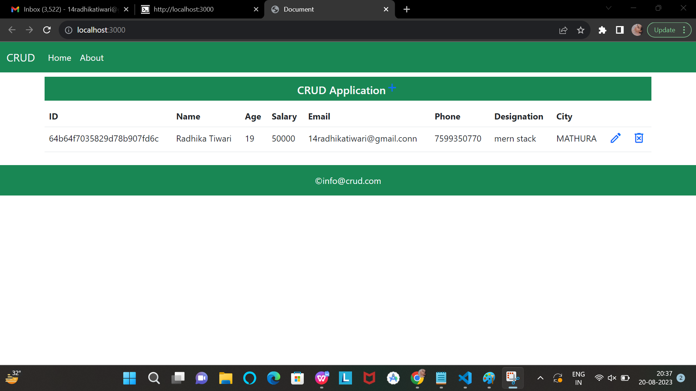
Create
Create allows you to add new rows/records to a database/table or other persistent storage. If the record does not exist, the create operation adds it to the database.
for create

Slide 7
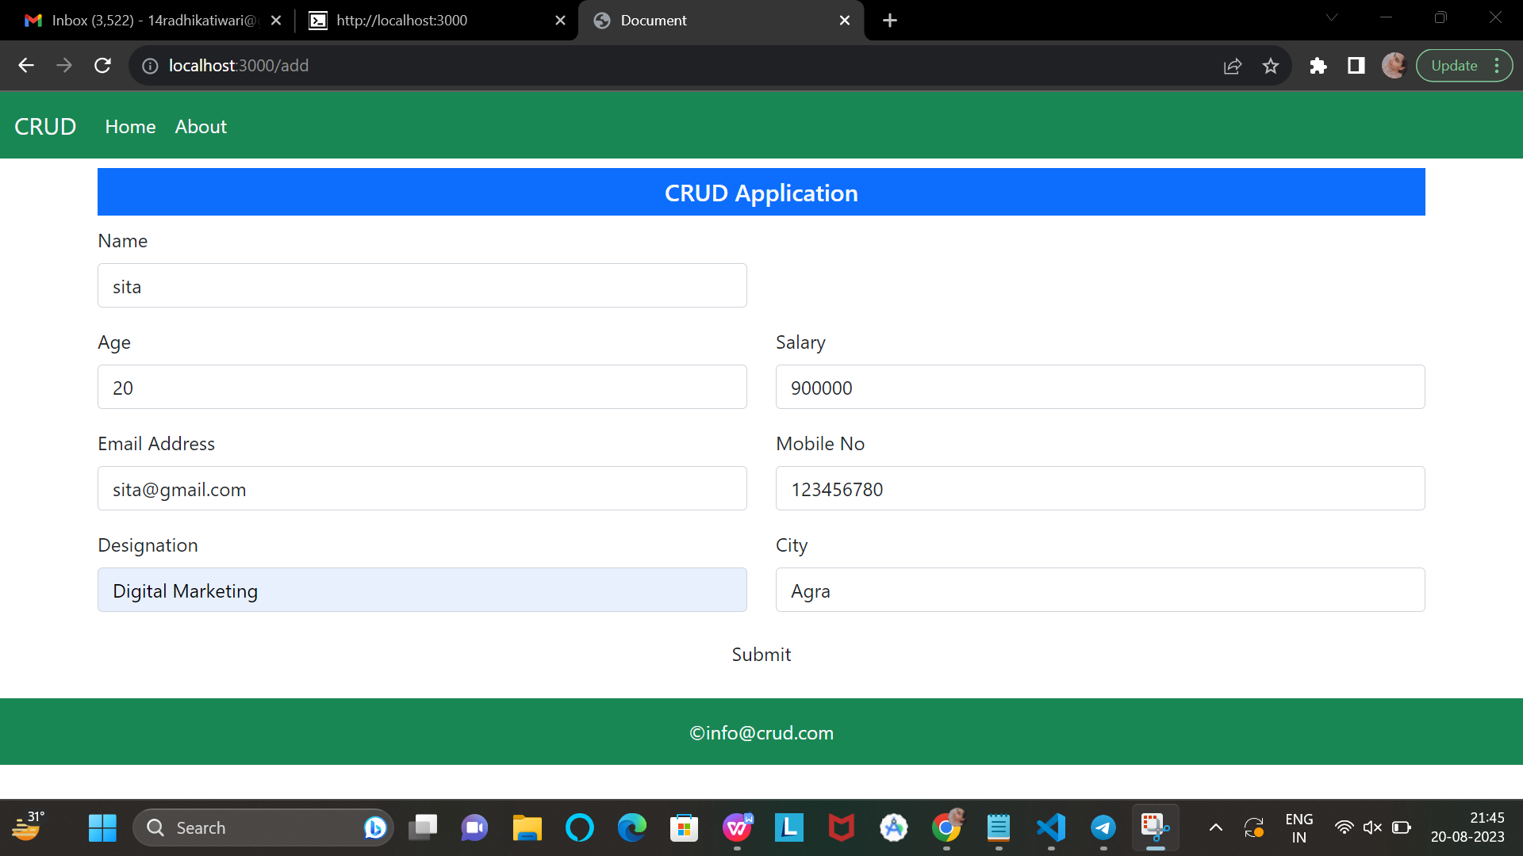
Read
Read is the operation that allows us to see the recipe we just created. It does not alter data. It simply displays it.

Slide 8
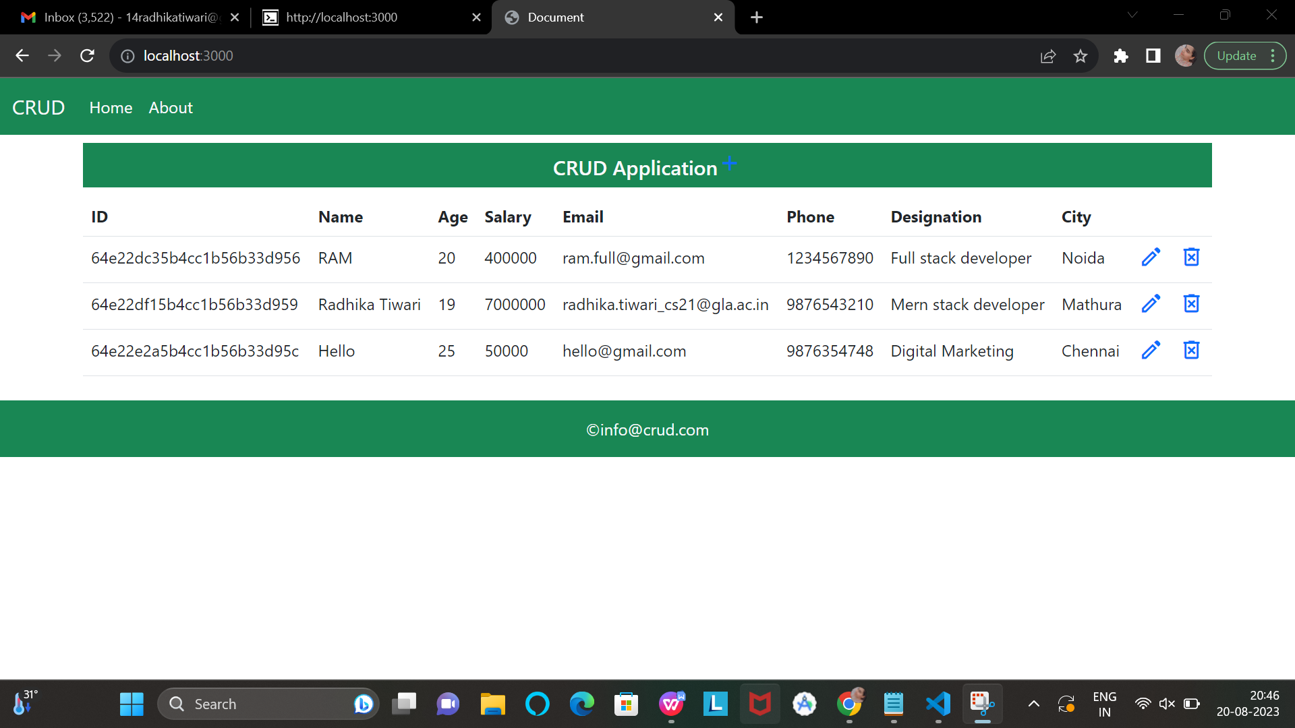
Update
Update is the operation that allows us to modify existing data and records within a table.
to edit any data

Slide 9
Delete
Delete is the operation that allows us to remove records from a table using a CRUD web application.
to delete any data

Slide 10
JSON(JavaScript Object Notation) package:
The "package.json" file is used to manage the dependencies required for a Node.js project. It lists the external libraries and modules (packages) that the project depends on to function correctly. These dependencies can be easily installed by running the npm install command, which reads the "package.json" file and installs the specified packages.

